Slide 1
Motion search: a video encoding complexity proxy
Ioannis Katsavounidis, Cosmin Stejerean
Meta
VQEG meeting: Dec. 2022

Slide 2
MPEG Video encoding process
DCT
Quant
ZigZag
Scan
VLC
-
Inverse
Quant
ME
Frame
Memory
01001101
Frame
Memory
Inverse
DCT
Motion Vector
VLC
+
Estimated by
residual AC-energy
Estimated by
Rate-distortion of
Gaussian source

Slide 3
Features
Performs I (intra-coded)/P (predicted) and B (bi-directionally predicted) frame type coding analysis
Configurable GOP (Group-Of-Pictures) structure
I-only => All-intra configuration (picture coding)
spatial complexity
I-PPP => Low-delay configuration (video-calling)
Faster configuration (half the time spent on searches)
I-B-B-P => Video-on-demand configuration
Configurable block size (currently 32x32)
Uses PMVFAST (fast diamond search) motion estimation

Slide 4
Software
Open source: https://github.com/facebookresearch/motion-search
C/C++ code with SIMD optimization (SSE2)
Opportunity to further accelerate through AVX/AVX2
Opportunity to run on mobile clients by adding ARM-NEON SIMD
Single-threaded, but can be easily multi-threaded at the frame level

Slide 5
Usage
git clone https://github.com/facebookresearch/motion-search.git
mkdir build; cd build; cmake .. ; make -j $(nproc)
/usr/bin/time -al bin/motion_search NETFLIX_ElFuente_1920x1080_14296frames_2997fps_001488_001590.yuv -W=1920 -H=1080 -b=0 output.txt

Slide 6
Performance (1080p)
18.5fps for I-P-P-P; 7.5MBytes
11.9fps for I-B-P; 10.5MBytes
10.4fps for I-B-B-P; 13.5MBytes

Slide 7
Understanding the results
pic picType count:I P B error bits
0 I 8160 0 0 576098 118692
1 B 984 290 6886 78470 94404
2 B 1111 335 6714 82693 94489
3 P 4925 3235 0 370356 109130
# of Intra-coded
16x16 blocks
# of P-coded
16x16 blocks
# of B-coded
16x16 blocks
Estimated bits to
code a frame
Residual AC-energy
After motion/DC prediction

Slide 8
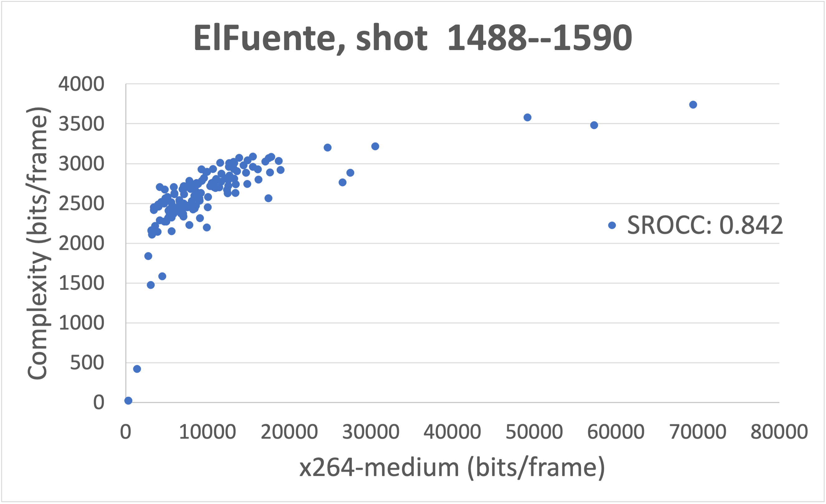
Accuracy

Slide 9
Future work
Report Motion Vector statistics per frame (average, variance)
Improve bit estimation (through ML)
Frame-level multi-threading
AVX/AVX2/ARM-NEON acceleration
Interface with MATLAB/Python
Add DCT-domain estimation (using VCA features)

